Slide 1
Voice-over-IP/Skype

Slide 2
Outline
Voice-over-IP Basic Principles
Skype – first VoIP over Peer-to-peer Infrastructure

Slide 3
Voice over IP (VoIP)
VoIP – transport of voice over IP-based networks
Complexity ranges from
  Using Internet to get free phone calls on peer-to-peer basis to
  Full scale PSTN (Public-Switched Telephone Network) replacement networks
VoIP must address
  Types of end user terminals - IP phones, PC clients
  Quality of Service – ensure agreed quality
  Security risks must be clearly identified
  Last mile bandwidth – which affects codec, packetization period and where to use compression to best meet service goals
  Signaling protocol must support service set required

Slide 4
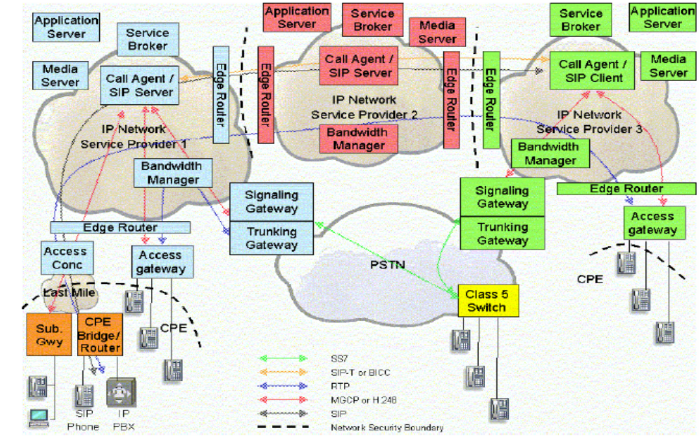
Next Generation VoIP Network (MSF – Multi-service Switching Forum Example)

Slide 5
MSF VoIP
Access Services Signaling protocol and network service signaling protocol: SIP
  Use RTP packets for telephony events
  Transport DTMF(Dual-tone multi-frequency signaling) tones out of band using the signaling protocol such as SIP
Quality of Service (Delay, Jitter, Packet loss)
  Use RSVP, DiffServ, MPLS, even ATM
  RTP is used for media traffic
Notes:
Multi-service switching forum: msf

Slide 6
Skype
Source: An Analysis of the Skype Peer-to-peer Internet Telephony Protocol, S. Baset, H. Schulzrinne,
2004
Rapid Identification of Skype Traffic Flows
P. Branch et al., NOSSDAV 2008

Slide 7
Skype Overview
Peer-to-peer (P2P) overlay network for Voice-over-IP (VoIP) and other application
Developed by Niklas Zennstrom and Janus Friis (founders of KaZaA, file-sharing company)
Users see Skype as an Instant Messaging (IM) software
Free on-net VoIP service and fee-based off-net SkypeOut service (allows calling to PSTN and mobile phones)
Runs on Windows, Linux, Pocket PC, …
Notes:
Please, use pictures from the web to show students interfaces of multimedia search and retrieval systems

Slide 8
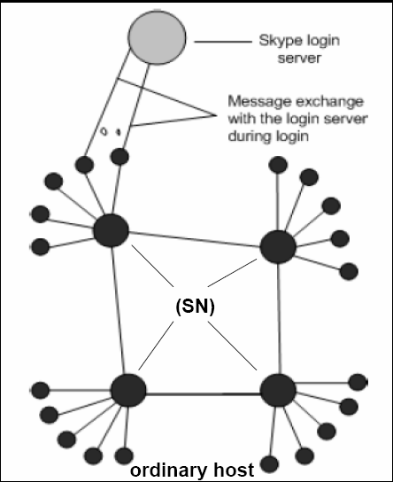
Skype Network
Super Nodes: Any node with a public IP address having sufficient CPU, memory and network bandwidth is candidate to become a super node
Ordinary Host: this host needs to connect to super node and must register itself with the Skype login server

Slide 9
Components of Skype
Ports
  Skype client (SC) opens TCP and UDP listening port configured in its connection dialog box
Host Cache (HC)
  List of super node IP address and port pairs that SC builds and refreshes regularly
  SC stores HC in the Windows registry
Codecs
  Wideband coded allowing frequencies between 50Hz-8KHz (one of the codecs is implemented by Global IP Sound)

Slide 10
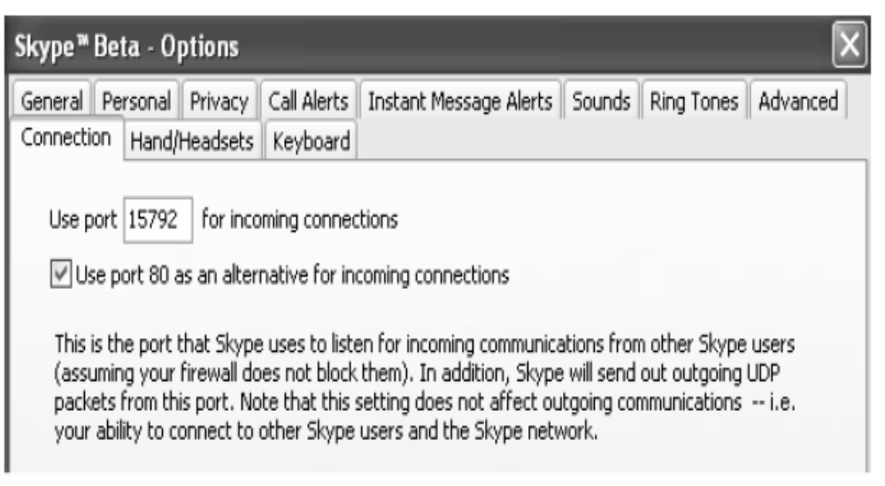
Skype Ports on which Skype listens for incoming connections

Slide 11
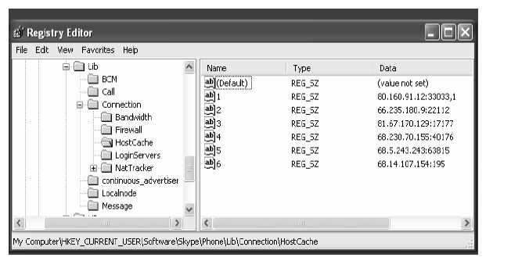
Skype Host Cache List

Slide 12
Components of Skype
Buddy List
  Skype stores buddy information in Windows registry
  Buddy list is digitally signed and encrypted, local to machine and not on a central server
Encryption
  Skype uses 256-bit AES encryption
  Skype uses 1536 to 2048bit RSA to negotiate symmetric AES keys
NAT and Firewall
  SC uses variations of the STUN and TURN protocols to determine type of NAT and firewall
Notes:
NAT: In computer networking, network address translation (NAT, also known as network masquerading, native address translation or IP masquerading) is a technique of transceiving network traffic through a router that involves re-writing the source and/or destination IP addresses and usually also the TCP/UDP port numbers of IP packets as they pass through. Checksums (both IP and TCP/UDP) must also be rewritten to take account of the changes. Most systems using NAT do so in order to enable multiple hosts on a private network to access the Internet using a single public IP address (see gateway). Nonetheless, NAT can introduce complications in communication between hosts and may have a performance impact.

Slide 13
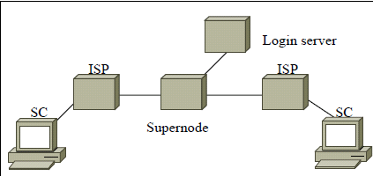
Skype Architecture

Slide 14
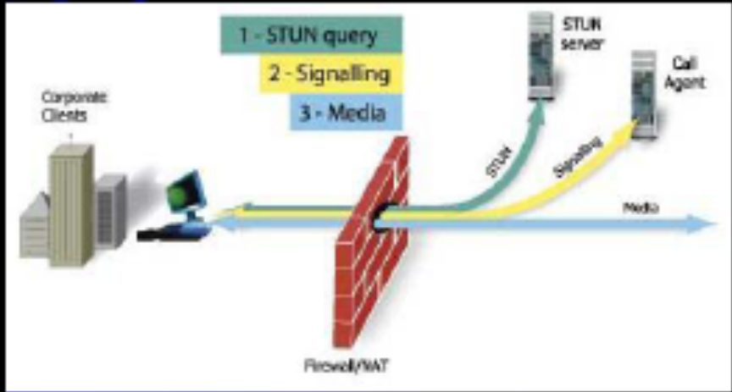
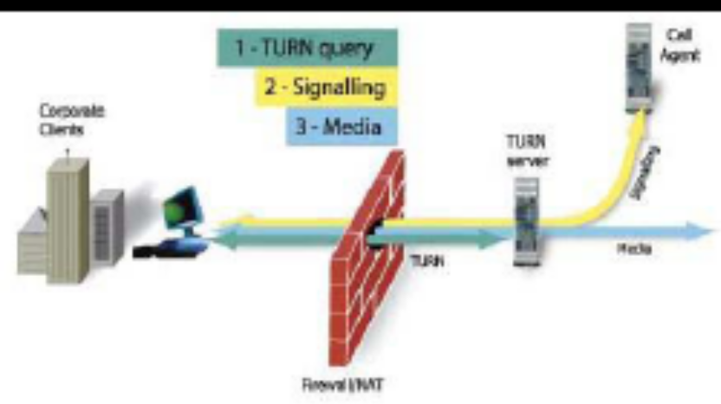

STUN and TURN
STUN (Simple Traversal of UDP through NAT)
  Client-server protocol
TURN (Traversal Using Relay NAT)
  Increase latency and packet loss
Notes:
Simple Traversal of UDP through NATs (STUN), is a network protocol allowing a client behind a NAT (Network Address Translator) to find out its public address, the type of NAT it is behind and the internet-side port associated by the NAT with a particular local port. This information is used to set up UDP (User Datagram Protocol) communication between two hosts that are both behind NAT routers. The protocol is defined in RFC 3489.
Protocol overview
STUN is a client-server protocol. A VoIP phone or software package may include a STUN client, which will send a request to a STUN server. The server then reports back to the STUN client what the public IP address of the NAT router is, and what port was opened by the NAT to allow incoming traffic back in to the network.
The response also allows the STUN client to determine what type of NAT is in use, as different types of NATs handle incoming UDP packets differently. It will work with three of four main types: Full Cone, Restricted Cone, and Port Restricted Cone. (In the case of Restricted Cone or Port Restricted Cone NATs, the client must send out a packet to the endpoint before the NAT will allow packets from the endpoint through to the client.) STUN will not work with Symmetric NAT (also known as bi-directional NAT) which is often found in the networks of large companies. With Symmetric NAT, the IP address of the STUN server is different than that of the endpoint, and therefore the NAT mapping the STUN server sees is different than the mapping that the endpoint would use to send packets through to the client. For details on the different types of NAT, see network address translation.
Once a client has discovered its external addresses, it can relate it to its peers. If the NATs are full cone then either side can initiate communication. If they are restricted cone or restricted port cone both sides must start transmitting together.
Note that using the techniques described in the STUN RFC does not necessarily require using the STUN protocol; they can be used in the design of any UDP protocol.
Protocols like SIP use UDP packets for the transfer of sound/video/text signaling traffic over the Internet. Unfortunately as both endpoints are often behind NAT, a connection cannot be set up in the traditional way. This is where STUN is useful.
The STUN server is contacted on UDP port 3478, however the server will hint clients to perform tests on alternate IP and port number too (STUN servers have two IP addresses). The RFC states that this port and IP are arbitrary.
Traversal Using Relay NAT (TURN) is a protocol that allows for an element behind a NAT or firewall to receive incoming data over TCP or UDP connections. It is most useful for elements behind symmetric NATs or firewalls that wish to be on the receiving end of a connection to a single peer. TURN does not allow for users to run servers on well known ports if they are behind a NAT; it supports the connection of a user behind a NAT to only a single peer. In that regard, its role is to provide the same security functions provided by symmetric NATs and firewalls, but to turn the tables so that the element on the inside can be on the receiving end, rather than the sending end, of a connection that is requested by the client.

Slide 15
Techniques used in Skype
Firewall and NAT traversal
Global decentralized user directory
Intelligent routing
Security
Super-simple UI

Slide 16
Login
During login process SC:
  Authenticates its user name and password with login server
  Advertises its presence to other peers and its buddies
  Determines type of NAT and firewall it is behind
  Discovers online Skype nodes with public IP addresses
Login server is the only central component in Skype network

Slide 17
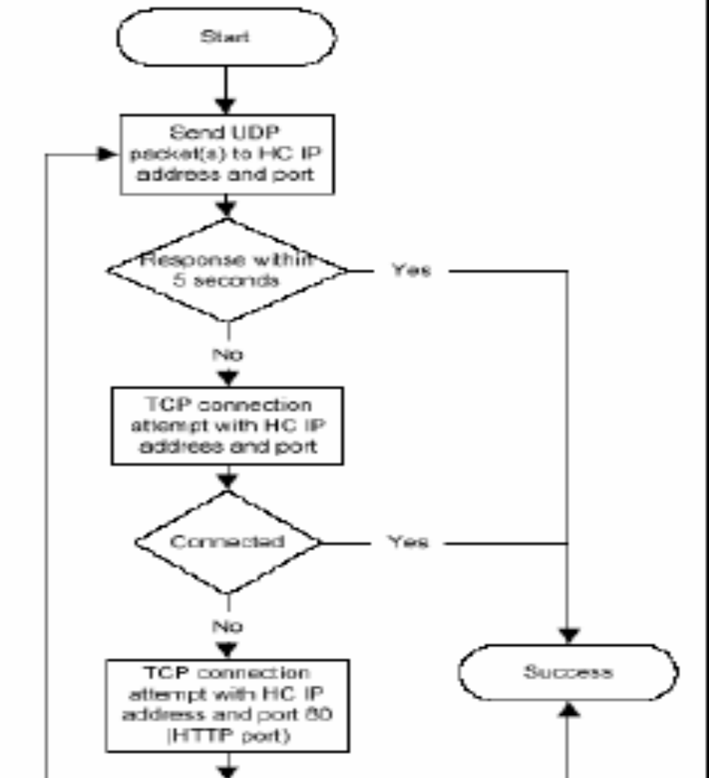
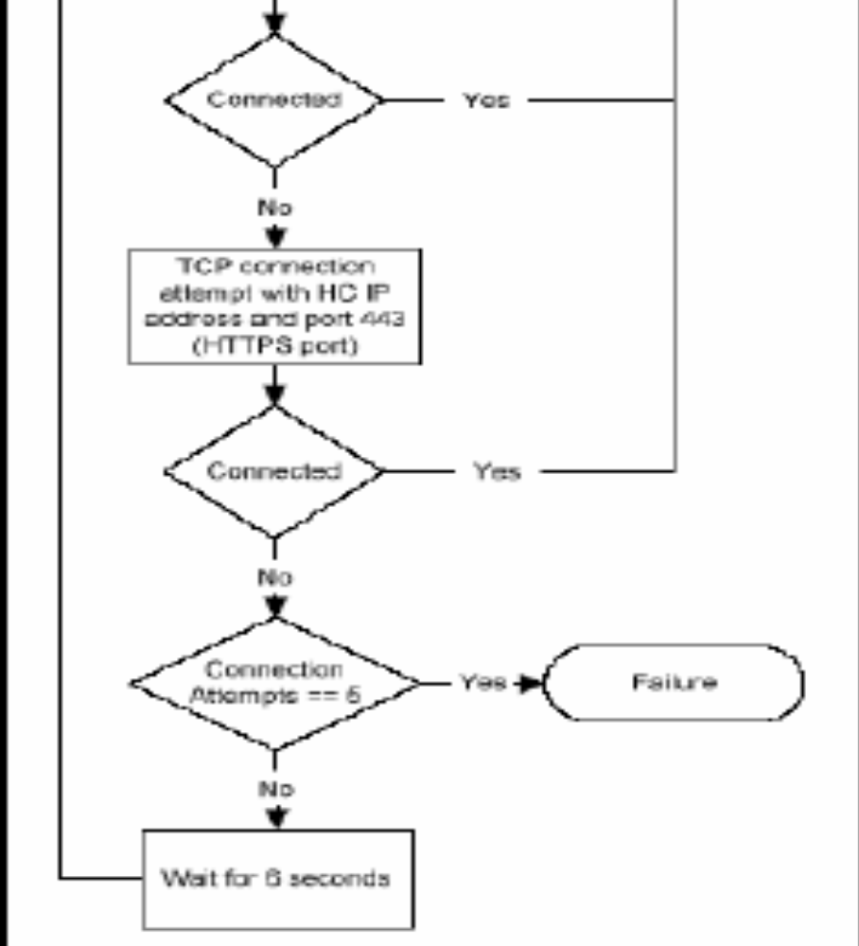
Skype Login Algorithm

Slide 18
Skype Login Process
After installation and first time startup, HC was observed empty
Bootstrap super nodes:
  After login for the first time after installation, HC was initialized with seven (IP, port) pairs
Bootstrap (IP, port) information either
  Hard coded in SC
  Encrypted and not directly visible in Skype Windows registry, or
  One-time process to contact bootstrap node

Slide 19
Skype Login Process
First time Login Process
  SC sends UDP packets to some bootstrap SNs
  SC establishes TCP connection with bootstrap SNs that respond
  SC perhaps acquires address of login server from SNs
  SC establishes TCP connection with login server, exchanges authentication information
Subsequent Login Process
  Similar to first-time login process
  SC uses login algorithm to determine at least one available peer and establishes TCP connection
  HC was periodically updated with new peers’ (IP, port)

Slide 20
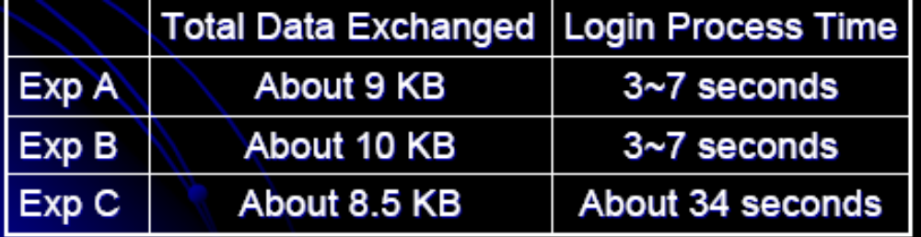
Skype Login Process
Comparison of three network setups
  Exp A: both Skype users with public IP address
  Exp B: one Skype user behind port-restricted NAT
  Exp C: both Skype users behind port-restricted NAT and UDP-restricted firewall
Message flows for first time login process
  Exp A and Exp B are roughly the same;
  Exp C only exchange info over TCP

Slide 21
User Search
Skype uses Global Index technology to search for a user
Skype claims that search is distributed and is guaranteed to find a user if it exists and has logged in during last 72 hours
Search results are observed to be cached at intermediate nodes

Slide 22
Call Establishment and Teardown
Call signaling is always carried over TCP
For user not present in buddy list, call placement is equal to user search plus call signaling
If caller is behind port-restricted NAT and callee is on public IP, signaling and media flow through an online Skype node which forwards signaling to callee over TCP and routes media over UDP
If both users are behind port-restricted NAT and UDP-restricted firewall, both caller and callee SCs exchange signaling over TCP with another online Skype node, which also forwards media between caller and calllee over TCP

Slide 23
Media Transfer and Codec
Bandwidth usage
  3-16 Kbytes/s
Skype allows peers to hold a call.
  To ensure UDP binding, SC sends three UDP packets per second to the call peer on average
No silence suppression is supported in Skype
min. and max. audible frequencies Skype codecs allow to pass through are 50 Hz and 8000 Hz.
Uplink and downlink bandwidth of 2KB/s each is necessary for reasonable call quality

Slide 24
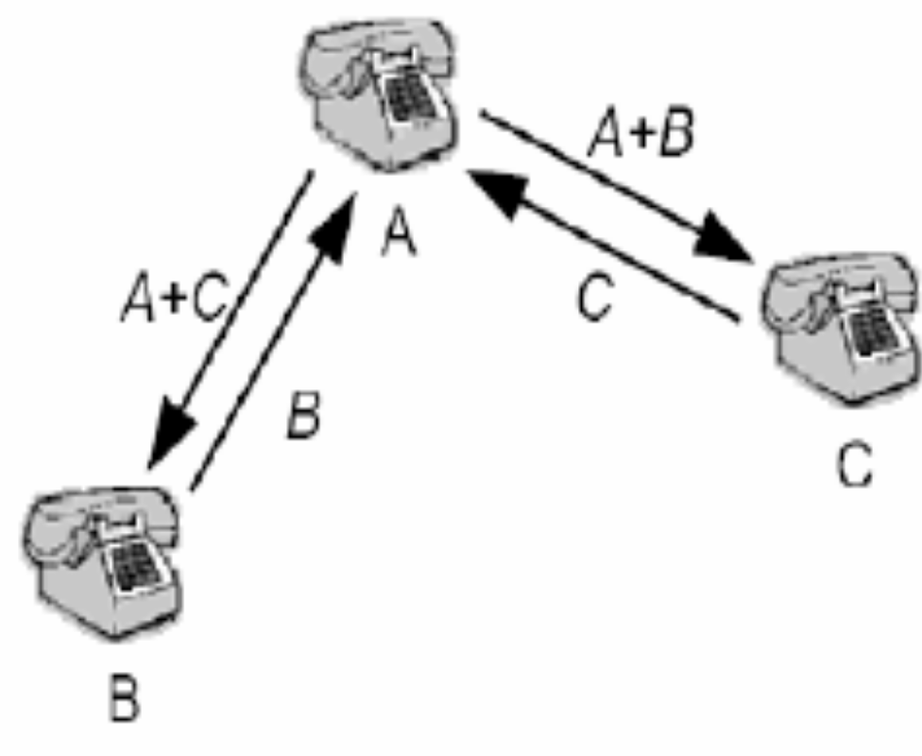
Conferencing
Node A acts as mixer, mixing its own packets with those of node B and sending to C and vice versa
For three party conference, Skype does not do full mesh conferencing
Most powerful machine will be elected as conference host and mixer
Two-way call: 36kb/s
Three-way call: 54kb/s

Slide 25
Impact of Skype
Impact on fixed-line operator
  Skype: SkypIN
Impact on mobile phone operator
  Skype embedded in Wi-Fi/mobile phone

Slide 26
Impact of Skype
Skype has shown, at least has suggested, the following
  Signaling, the most unique property of traditional phone systems, can now be accomplished effortlessly with self-organizing P2P networks
  P2P overlay networks can scale up to handle large-scale connection-oriented real-time services such as voice

Slide 27
Conclusion
Statistics from the paper 2004 -
More than 2 million on-line subscribers per day
More than 2.7 billion minutes served (minutes of free Skype-to-Skype callees)
More than 38 million of software download
More than 7 million of registered subscribers
More than 1 million concurrently on-line subscribers

